Slide 1
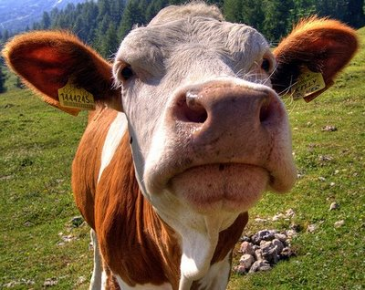
Cows!

Slide 2
Some language:
The word cow comes from all of these words;
Old English -cū
Old Norse -kӯr
Old High German -kuo
Latin -bōs
Greek -boūs
Sanskrit -gāŭs

Slide 3
The word cow also means;
The mature female of any species of cattle.
The mature female of various other mammals, such as the elephant, whale, and seal
Or any domestic species of cattle.

Slide 4
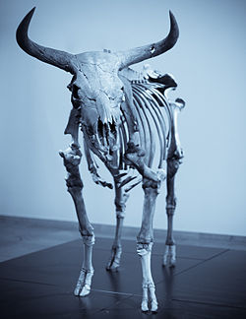
Evolutionary history
Modern species of Bos are thought to have evolved from a single ancestor, the aurochs This particular species survived until the early 17th century when it was hunted to extinction.
An aurochs skeleton ----→

Slide 5
Why are cows special?
The special features of cows include a body mass in excess of 450 kg. Their digestive track has four compartments. There are cows with horns or no horns at all. This depends upon their breeding and genetics
Cattle have 32 teeth. They have 6 incisors and 2 canines in the front.

Slide 6
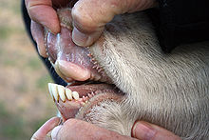
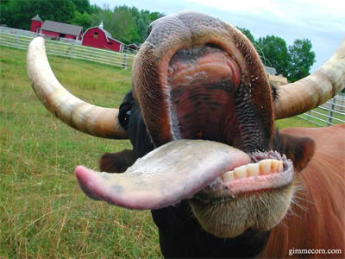
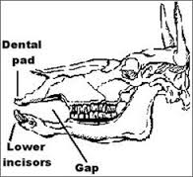
Cows...mouth
The dental pad or browsing pad is a feature of the cow that results from a lack of upper incisors and helps them gather large quantities of grass and other plant matter

Slide 7
Breeding and herds
Most Bos species have a lifespan of 18–25 years in the wild, with up to 36 being recorded in captivity.
They have a 9–11 month gestation, depending on the species, and rarely have two young in the spring.
Most species travel in herds ranging in size from 10 members into the hundreds. Within most herds, there is one bull for all the cows.
They are generally diurnal, resting in the hot part of the day and being active morning and afternoon.
Some species are also migratory, moving with food and water availability.

