Slide 1
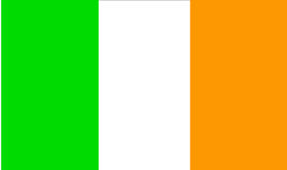
Ireland
By: Emma Towey

Slide 2
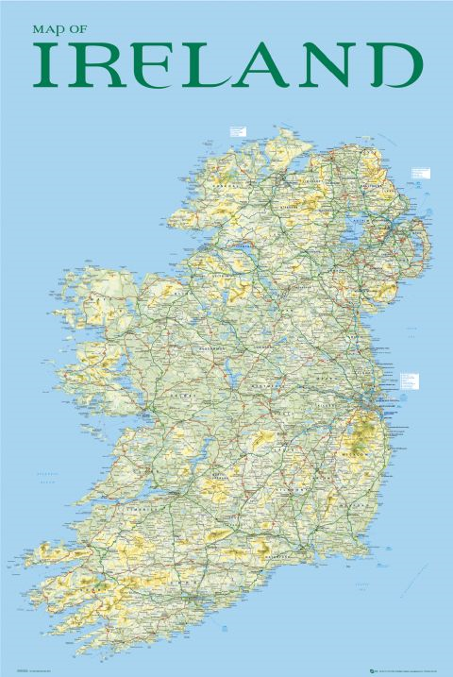
FACTS ABOUT IRELAND
Before the famine in 1841 the population of Ireland was 6.5 million people.
Today the population is 4.5 million people.
The capital city of Ireland is Dublin.
There are 26 counties in the republic of Ireland and there are 6 counties in Northern Ireland.
Dublin, Cork, Limerick, Galway and Waterford are the five main cities in Ireland.

Slide 3
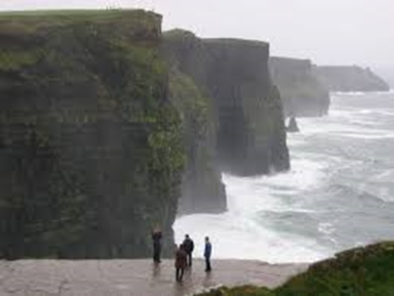
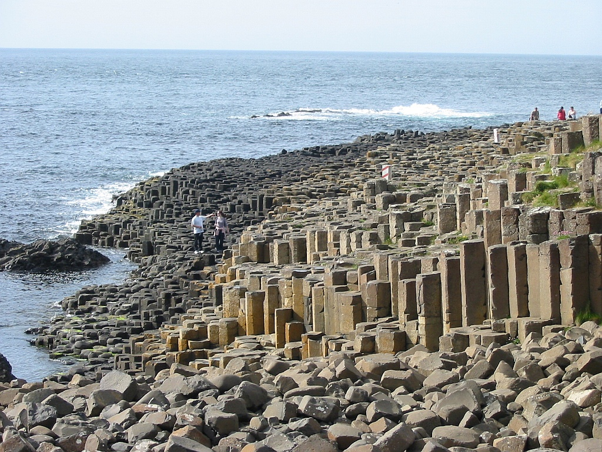
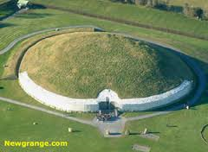
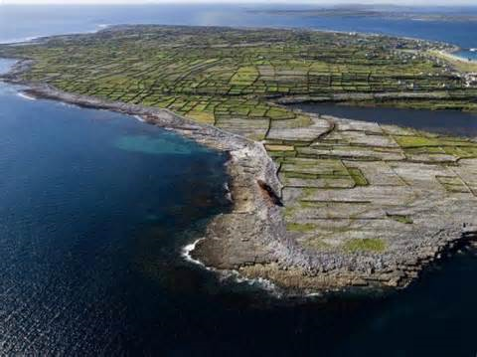
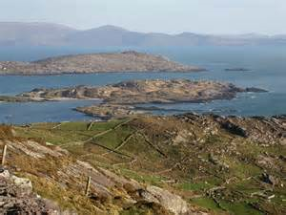
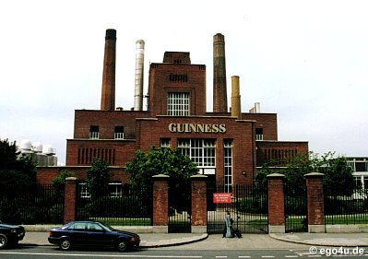
Famous tourist attractions in Ireland
There are many famous tourist attractions in Ireland
The top ten are:
1. Cliffs of Moher
2. Boyne Valley
3. Ring of Kerry
4. Giants Causeway
5. Aran Islands
6. Guinness Storehouse
7. Trinity College Dublin
8. The Burren
9. St. Patricks Cathedral
10. Croke Park

Slide 4
MORE FACTS ABOUT IRELAND
Ireland is in Europe, so therefore it’s a European country.
Leinster, Munster, Ulster and Connaught are the four provinces in Ireland.
There are 3,300 primary schools and 2,700 secondary schools in Ireland.
Cork is the largest county and Louth is the smallest.

Slide 5
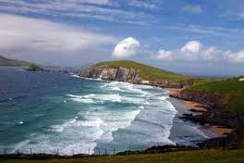
Best known beaches in Ireland
The best known beaches in Ireland are:
1. Bettystown Co.Meath
2. Skerries Co. Dublin
3. Dollymount Strand Co.Dublin
4. Brittas Bay Co.Wicklow
5. Baginbun Head Co.Wexford
6. Inch Strand Co.Kerry
7. Fanore Co. Clare
8. Thallaban Co.Mayo
9. Ballymastocker Bay Co.Donegal
10. Benone Strand Co. Londonderry

Slide 6
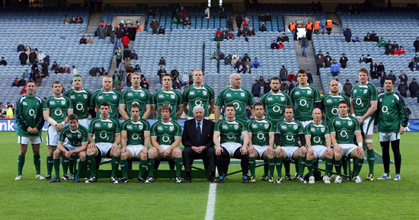
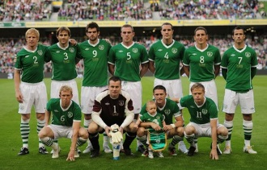
Sport
Irelands Rugby Team
Irelands Soccer Team
- The End -

