Slide 1
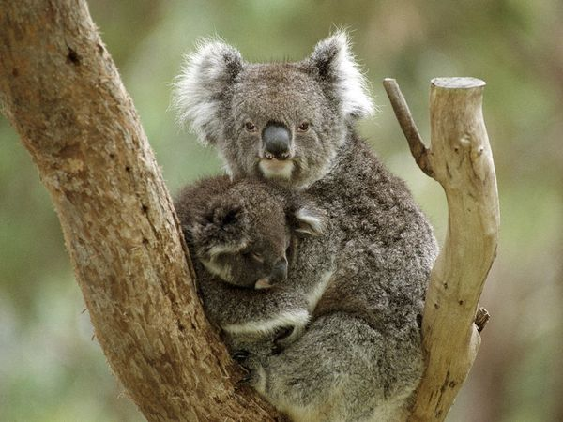
Koala’s
By: Caoimhe Leamy

Slide 2
Where Koala’s live?
Koala’s are native to Australia
You can find Koalas in many zoo’s

Slide 3
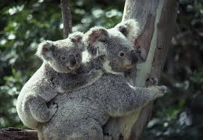
Are Koala’s friendly?
Koala’s are very friendly because they have been seen to be rubbed and hugged in zoo’s
If you annoy them they will get angry as any other animal would

Slide 4
How long do Koala’s live?
Koala’s live up to12 to 16 years
Female Koala’s live longer than male
Koala’s do

Slide 5
Their appearance
They can be brown, grey, black and white
They have a big, hard , black nose
They have brown and black eyes
They are also very furry

Slide 6
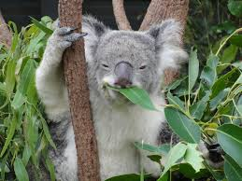
What Koala’s eat?
Koala’s eat eucalyptus leaves
They are very picky eaters
If they don’t find any eucalyptus leaves they will not eat
Koala’s have occasionally been known to eat foods like wattle, tea tree, paper bark and pine species

Slide 7
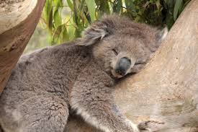
What Koala’s like to do?
Koala’s like to climb tree’s
They eat up to 200 to 500 grams of leaves per day
They sleep up to 16 hours per day in order to conserve energy

Slide 8
What size is the biggest koala?
An adult Koala from Australia’s northern regions can grow to a length of 740 mm and 9 kg in weight for males
For females they can grow to 720 mm and 7.25kg in weight

