Slide 1
Liverpool F.C
BY EOGHAN HORGAN

Slide 2
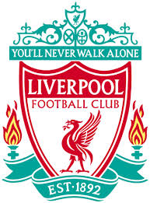
Liverpool Football Club is an English Premier League football club based in Liverpool. Liverpool F.C. is one of the most successful clubs in England.
Liverpool was established in 1892. It joined the league a year later.

Slide 3
This is the difference in todays kit and their first ever kit

Slide 4
They still have the same stadium that they used back in 1893, it’s called Anfield

Slide 5
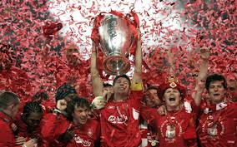
Liverpool Have won
18 League Titles
5 Champion Leagues
7 F.A Cups
8 League Cups

Slide 6
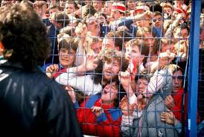
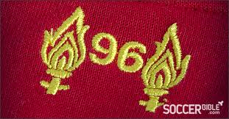
Hillsborough!! Liverpool Vs Nottingham Forest
Disaster strikes, everybody tries to run on to the field and 96 Liverpool supporters die in a crush

Slide 7
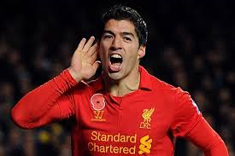
Luis Suarez is probably Liverpool’s best player at the moment, with a total of 23 goals scored so far!

Slide 8
The End
Any questions?

