Slide 1
Nuclear Fusion
By Conor McCarthy

Slide 2
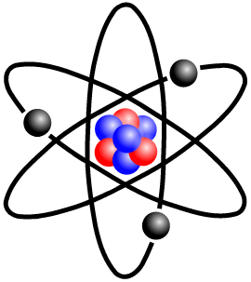
What is an atom?
Everything is made out of atoms. Atoms are super tiny.
The following is a diagram of an atom.

Slide 3
The Process of Nuclear Fusion
Nuclear fusion is created through a particle accelerator. You would need a particle accelerator an estimated 1 mile long to meet the required speeds, however, scientists are working on a particle accelerator smaller than a grain of rice!
Nuclear fusion is created when two light atoms collide into each other at insane speeds to create another type of heavier atom.
All matter is not conserved in the process, so a particle is wasted in the operation, the particle lost disappears after about two seconds. The two other atoms also dispense half their mass.

Slide 4
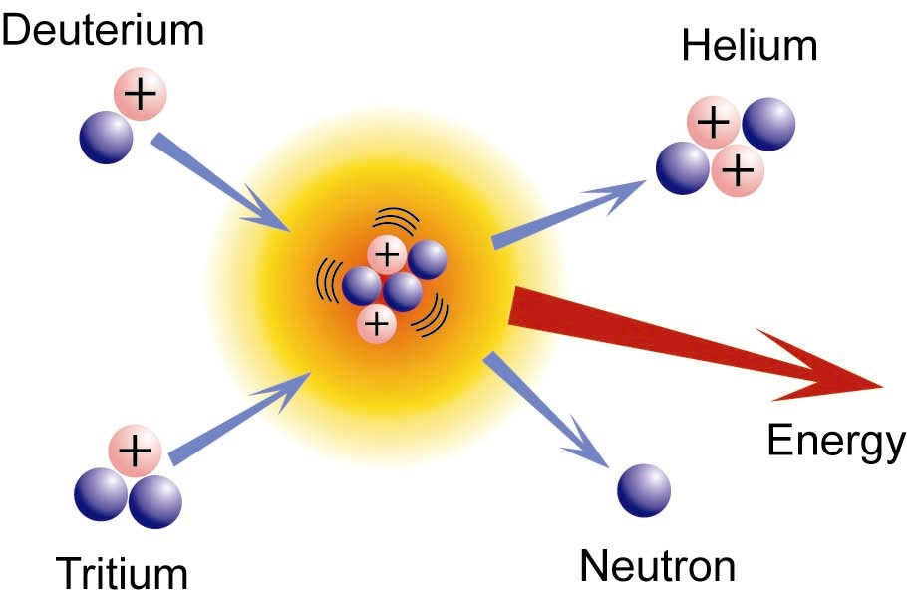
The Process of Nuclear Fusion

Slide 5
Where does Nuclear Fusion Happen?
Although you can create nuclear fusion through a particle accelerator, at the moment it’s really just used for studying purposes, so what actually uses nuclear fusion for energy?
All active stars use nuclear fusion to prevent them from collapsing in on themselves.
When a star reaches the end of it’s life span, it will shrink into a white dwarf or turn into a black hole. This depends on it’s mass, if the star is less than 1.4 of the mass than our sun, it will turn into a white dwarf, and if it is more than 1.4 of the mass of our sun, it will turn into a black hole.

Slide 6
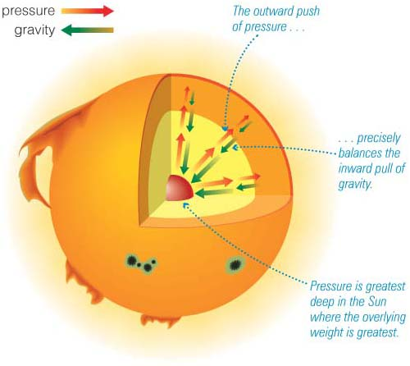
Nuclear Fusion Inside The Sun

Slide 7
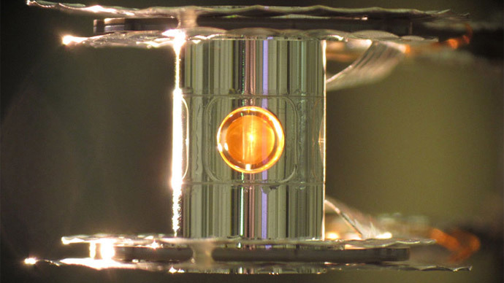
Recent Nuclear Fusion Study
A team of scientists in California have recently announced that one of their experiments has yielded more energy out of the fusion than was originally used to create the reaction.

Slide 8
When was Nuclear Fusion Discovered?
Nuclear Fusion was discovered in 1929 by a group of two scientists, Atkinsons and Houtermans.
They discovered that energy could be created through fusing nuclei together.
There have since been discoveries made by scientists such as Hans Bethi, Mark Oliphant, and Enrico Fermi.

Slide 9
The End.
I hope you liked my presentation, if there is things that I haven’t explained enough or haven’t explained at all, feel free to ask for a brief explanation!

