Slide 1
Snow Leopards
By Rebecca Keane
February 2004

Slide 2
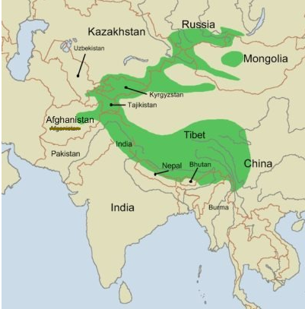
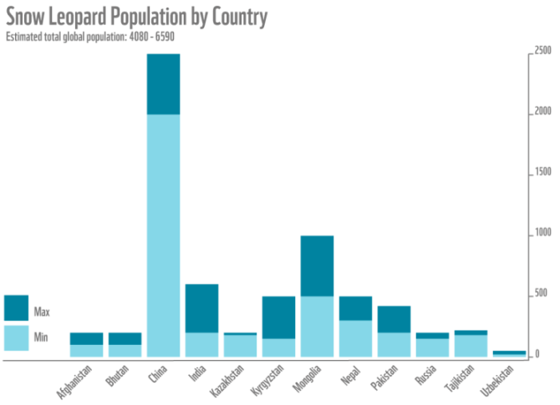
Where they live - Habitat
Mountains of central Asia
Siberia, China, India, Mongolia, Nepal & Russia
Prefer steep terrain, cliffs, rocky outcrops, ravines etc.
Pop. 4,000 to 6,500
China 2000
In Nepal 300

Slide 3
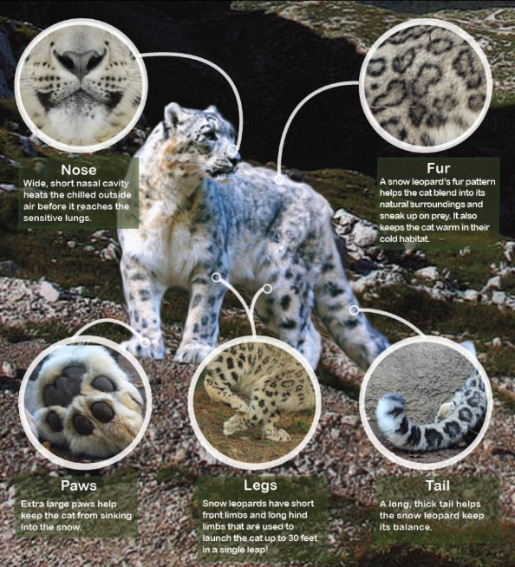
Physical Features
Adult around 120 to 150 cm long
Tails 90cm long
Males 30 % bigger
Feet are natural snow shoes
When they sleep wrap tail around like a scarf

Slide 4
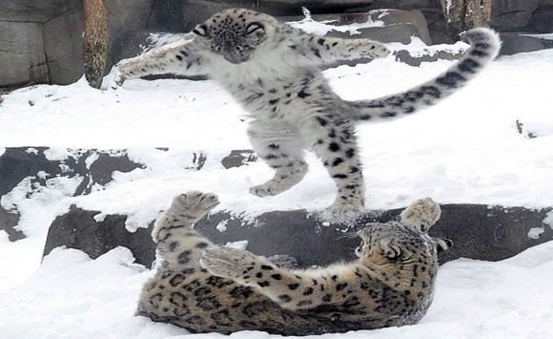
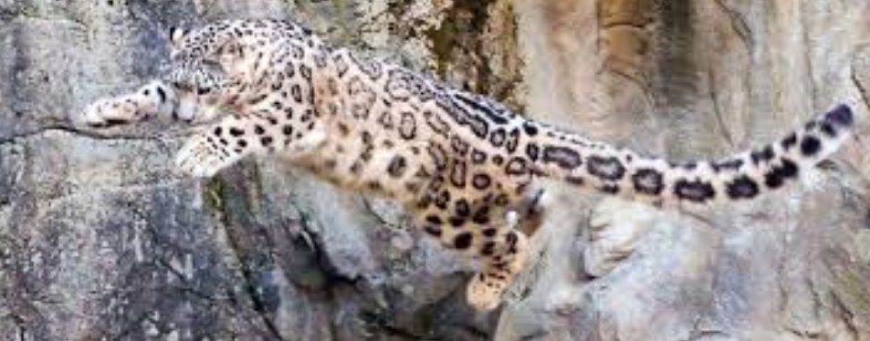
Diet
Their main prey- Himalayas blue sheep , ibex and musk deer
They catch prey by pouncing from as far as 15 metres away

Slide 5
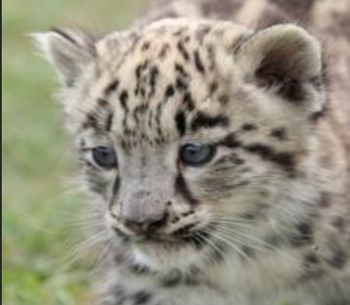
Breeding
The mating season is between January and May
Cubs are born in late spring or early summer
Maybe 1-4 cubs in a litter but it is most likely that their will be 2-3
Cubs leave their mum at 18-22 months
http://www.youtube.com/watch?v=bd1W_818gPk

Slide 6
Conservation
Listed as Endangered Species
Illegal to hunt or trade
Natural prey is disappearing
What can we do?
Raise awareness about their plight
Adopt a snow leopard (like mine ☺ )

Slide 7
Adopt a Snow Leopard
Click to play..

Slide 8
Thank you...
Questions ?

