Slide 1
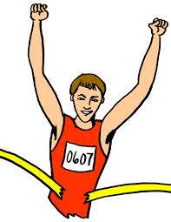
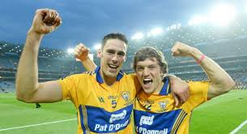
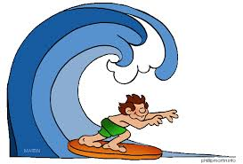
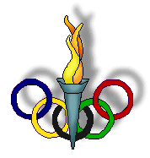
Sports in Ireland
By Aoife Madigan

Slide 2
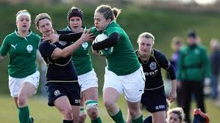
Ireland has a population of approximately 4.5 million people. For such a small nation we have always competed at a very high standard at international level in many sporting discipline’s. Ireland has had much success in past European, World and Olympic Games in sports such as athletics, swimming, boxing, sailing, rowing, equestrian, shooting.
We are also very strong competitors on the world stage in other sports such as golf, irish dancing, soccer, snooker, surfing, wind surfing, surf lifesaving, horse racing and of course rugby.
Currently Ireland are looking very strong in the RBS Six Nations rugby tournament.

Slide 3
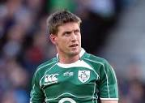
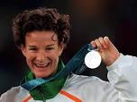
Some famous Irish sports people of modern times include
Katie Taylor
Ruby Walsh
Tony McCoy
John Joe Nevin
Rob Heffernan
Brian O’Driscoll
Ronan O’Gara
Roy Keane
Sonia O’Sullivan
Rory McIlroy

Slide 4
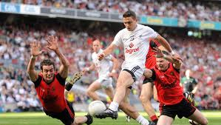
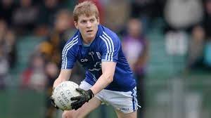
Some of the many sports played and followed in Ireland include horseracing, show jumping, grey hound racing, handball , squash, athletics, motorsport ,boxing, badminton, soccer, tennis , road bowling, hurling, Gaelic football and hand ball.
Hurling, Gaelic Football, Handball and Road Bowling are all unique to Ireland, as a result of the Irish emigrating they are now played all over the world.
Gaelic football is the most popular sport in Ireland in terms of match attendance at 34%, followed by hurling at 23%, soccer at 16%, and rugby at 8%.The All Ireland Football Final is to be the most watched event of the nation’s sporting year. Soccer is the most played team sport in Ireland.

Slide 5
The basic rules are simple:
A bowl (A heavy cast iron ball is thrown from a start point to a predetermined end point, usually 1-2 miles away.
The winner being the person/team who reaches the end in the least number of throws.
The bowls themselves vary in weight. Adults play with a 28oz (0.8kgs) bowls while juniors use a 14oz (0.4kgs) bowl.
No other special clothes or equipment is required to play. Just a bowl and an available road.
Despite its simple rules the best players are truly skilful.
http://www.youtube.com/watch?v=z-JJ5l0_vJI&feature=youtu.be

Slide 6
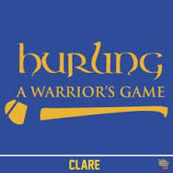
Hurling is a sport native to Ireland. In terms of attendance figures, hurling is second only to Gaelic Football. Many aspects of hurling are similar to football, as both sports are organised by the GAA.
The game is like shinty and hockey however the ball (sliotar) is rarely played along the ground. Hurling is played on a large pitch and is a lot faster than hockey.
Hurling is the second faster speed game in the world after ice hockey. In terms of excitement and entertainment nothing can compare to a good game of hurling.
Proof of this was the 2013 All Ireland Senior Hurling Final between Clare and Cork.
This was reported to be the best All Ireland Hurling Final ever played. Clare also won the U21 Hurling Final which was played in Thurles beating Antrim.

Slide 7
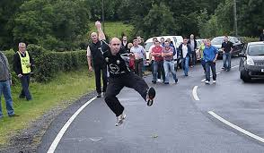
Road Bowling is an ancient sport. It is based in Ireland (particularly in Cork and Armagh) but is also played in the US and the UK. Similar sports are played in Holland, Germany and Italy.
Since the 1960’s the sport has been enjoyed with a championship being played on a regular basis by athletes from all of these countries. Road Bowling is usually referred to as Bowls.
It is played on public roads usually on a Sunday all over the West Cork area gathering large and enthusiastic crowds of spectators. Bowls is nothing like 10 pin bowling or the type of bowling played on a manicured greens!!!

Slide 8
Tug of War
The tug of war is not native to Ireland but has been in Ireland a long time. Ireland is able to compete in International events, such as Tug of war International Federation World Championship
There are approximately 60 clubs joined to the Irish Tug of war association. Tug of War teams usually have 8 pullers, the last puller on the rope is called the anchor.
Contest of 2 teams are the best of 3 pulls. The aim of the game is to pull the opposing team 4 metres to win the pull.
Ireland is considered as 1 of the top countries in International Tug of War having won many medals at both club and country levels down through the years. Tug of War is on the waiting list to be reinstated to the Olympic Games.

Slide 9
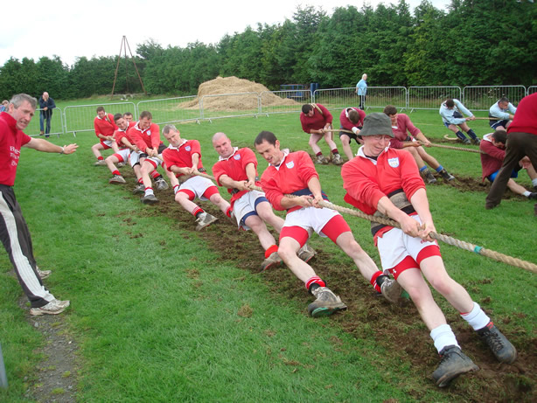
The Corofin Tug of war teams is one of the best teams in the World. Down through the years Corofin have won at Regional, National and International levels.
“COME ON COROFIN!!!”

Slide 10
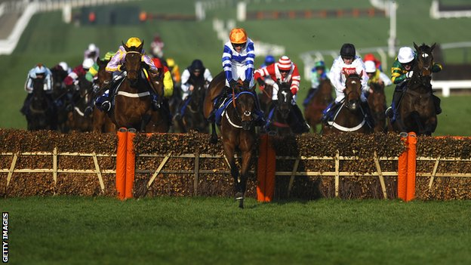
Horse Racing is very popular in Ireland. Horse racing consists of two separate disciplines, jump racing and flat racing.
Jump racing involves a horse and jockey racing and jumping over fences at a gallop over medium to long distances of up to four miles!!!
Flat racing involves sprinting short distances with no jumping involved. In Ireland our main race tracks are the Curragh, Fairyhouse, Leopardstown and Punchestown, however there are many others race tracks spread throughout the country.
Some of the biggest annual races to occur in Ireland are The Grand National, The Irish Derby and The Irish Oaks. Although the most popular race meeting for Irish supporters occurs in Cheltenham, England.In March each year.

Slide 11
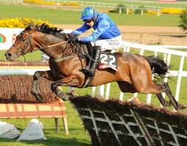
Some of the greatest Irish horses include as follows:
Danoli( da-no-lee)
Shergar
Arkle
Quevega
Istabraq
Champagne Fever
And of course the most famous of modern times has to be HURRICANE FLY. Who has won the most grade1 races of all times!!!

Slide 12
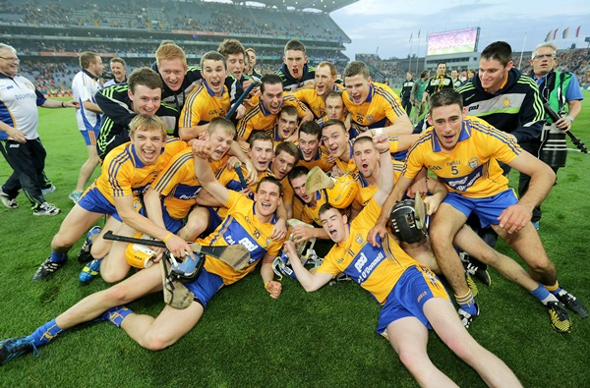
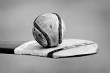
As you can see Ireland has a very good sporting history and we hope that it continues into the future for many years to come.
Hopefully in the future we will have many more Olympic, World and European titles.
In Clare we wish Davy and his men all the best for the 2014 All Ireland Championship.
UP THE BANNER

