Slide 1
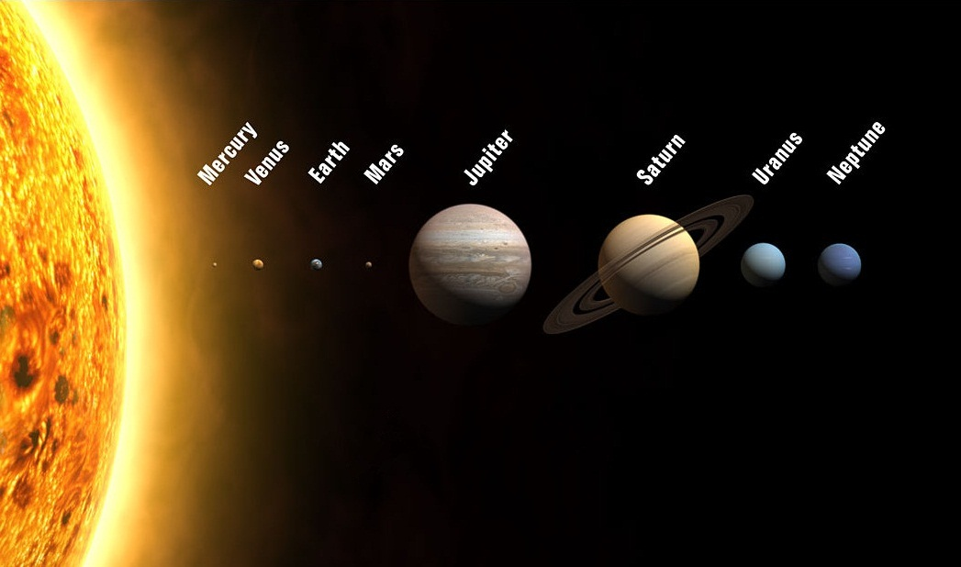
The Solar System (The inner planets)

Slide 2
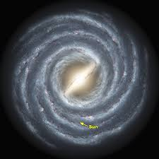
The Solar System
The Solar System is the family of planets that we live in.
It is located in one of the arms in the Milky Way galaxy.
There are eight official planets in the Solar System: Mercury, Venus, Earth, Mars, Jupiter, Saturn, Uranus and Neptune.

Slide 3
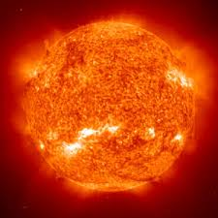
The Sun
The Sun is a giant ball of burning gas which is at the centre of the Solar System
If you went around the Sun you would have travelled approximately 4,366,813 kilometres
The Sun loses about 4,500,000 tonnes of weight every second

Slide 4
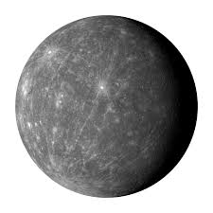
Mercury
Mercury is the closest planet to the Sun
Mercury is named after the ancient Roman God of travel and finance
On Mercury the temperature ranges from -173 to 426 Celsius
Mercury is the smallest planet with a diameter of about 482 km

Slide 5
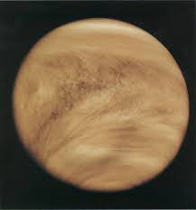
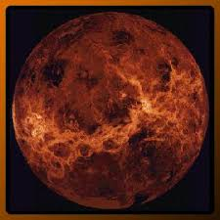
Venus
Venus is the hottest planet in the Solar System reaching a temperature of 462 Celsius
Venus is named after the ancient Roman Goddess of beauty
Venus’ day (8 months) is longer than its year (7 ½ months)
Even though Venus’ temperature is so high it’s clouds temperature ranges from -43 to -173 Celsius
Venus with clouds Venus without clouds

Slide 6
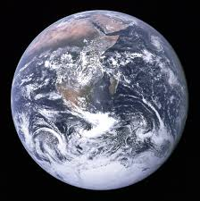
Earth
Earth is our home planet and is the only planet so far known to have life
Earth is the only planet known to have water on it, covering 71% of the Earth’s surface, though there is thought to be water on one of the moons orbiting Jupiter
Earth’s name comes from old English and German, unlike the rest of the planets which are named after Roman Gods and Goddess
Earth only has one moon

Slide 7
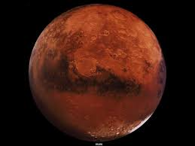
Mars
Mars is the only planet other than Earth that could sustain life
It has the highest mountain in the Solar System called Olympus Mons
Mars is named after the ancient Roman god of war
Mars has two moons Deimos and Phobos
Astronomers are planning to have human colonies on Mars

Slide 8
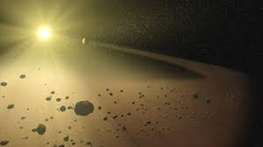
The Asteroid Belt
The Asteroid Belt is the divider between the inner and outer planets
It contains many dwarf planets like Vesta, Juno, Ceres and Pallas

Slide 9
The Solar System (The Outer Planets)

Slide 10
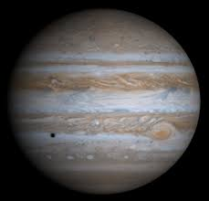
Jupiter
Jupiter is the biggest planet in the Solar System
Jupiter is named after the ancient Roman king of the gods
Jupiter has a storm around the size of Earth that has been on going for 300 years which is called The Great Red Spot because of it’s red colour
Jupiter is covered in clouds swirling around the planet
Jupiter has 63 moons, one of them, Ganymede, is the biggest moon in the Solar System
Another moon, Europa, is covered in ice which is thought to be covering an ocean of water which could contain life

Slide 11
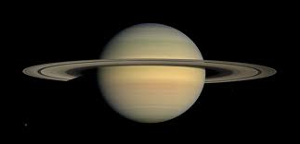
Saturn
Saturn is surrounded by the most noticeable rings in the Solar System
The rings are made up of ice and rock some the size of a grain of sand and some the size of a house
Saturn is named after the ancient Roman god of agriculture
The rings move at a speed of about 1,100 miles per hour

Slide 12
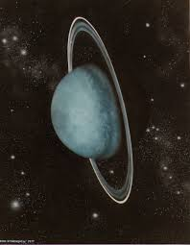
Uranus
Uranus is different because it is tilted at almost a ninety degree angle. It is thought this happened when an asteroid hit it and put it that way
Uranus is named after the ancient Roman god of the sky
It is more 2.76 billion kilometres from the sun

Slide 13
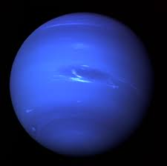
Neptune
Neptune is the furthest planet from the Sun
Neptune temperature reaches -218 Celsius
The Dark Spot on Neptune is the same as the Great Red spot on Jupiter just darker and blue
The winds on Neptune reach 2400 kilometres
Neptune is named after the ancient Roman god of the sea

Slide 14
The Kuiper Belt
The Kuiper belt is the same as the Asteroid Belt just beyond Neptune
It is so big that a dwarf planet called Sedna takes 20,000 years to orbit the Sun
The Kuiper Belt is about 4,500,000,000 kilometres long

